Slide 1

RUNGTA COLLEGE OF DENTAL SCIENCES & RESEARCH
TITLE OF THE TOPIC : Stability in Complete Dentures
DEPARTMENT OF PROSTHODONTICS AND CROWN & BRIDGE

Slide 2
Specific learning Objectives
At the end of this presentation the learner is expected to know ;
Core areas* | Domain ** | Category #
Definitions | Cognitive | Must Know
Stability | Cognitive | Must Know
Factors effecting stability | Cognitive | Must Know
Support | Cognitive | Must Know
Factors effecting support | Cognitive | Must Know
Conclusion | Cognitive | Must Know
Take home message | Cognitive | Must Know
References | Affective | Desired to know

Slide 3
Contents
Definitions
Stability
Factors effecting stability
Support
Factors effecting support
Conclusion
Take Home Message
References

Slide 4
Stability
The quality of a removable dental prosthesis to be firm , steady or constant to resist displacement by functional horizontal or rotational stresses. (GPT 9)

Slide 5
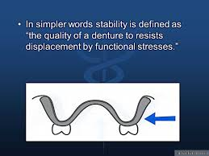

Slide 6
SUPPORT
the resistance to vertical forces of mastication and to occlusal or other forces applied in the direction towards the basal seat. (GPT 8)
According to Boucher,
Support is the resistance of a denture to the vertical components of mastication and to occlusal or other forces applied in a direction towards the basal seat.

Slide 7
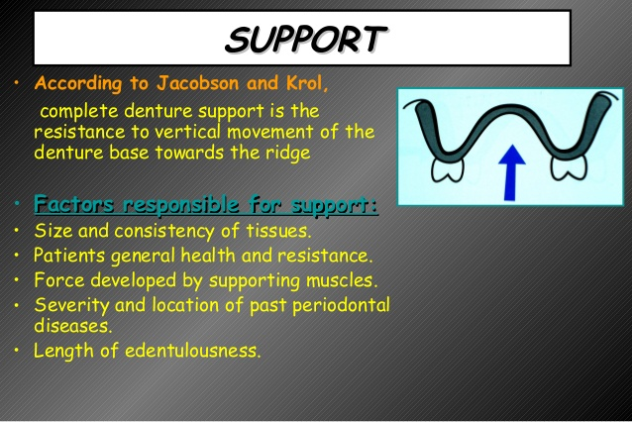

Slide 8
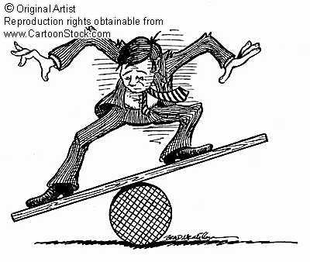
STABILITY
Fish in 1948 …
  Impression surface
  Occlusal surface
  Polished surface
FACTORS CONTRIBUTING TO STABILITY
  RELATIONSHIP OF DENTURE BASE TO UNDERLYING TISSUES
  RELATIONSHIP OF EXTERNAL SURFACE AND PERIPHERY TO SURROUNDING ORO FACIAL MUSCULATURE
  RELATIONSHIP OF OPPOSING OCCLUSAL SURFACES

Slide 9
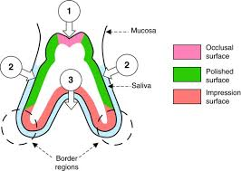

Slide 10
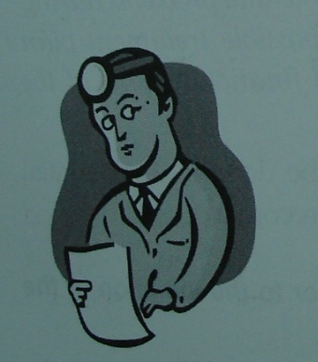

Diagnosis
The examination of edentulous mouths can provide information necessary to make a diagnosis that will relate directly to the retention and stability of mandibular dentures.
The question is how one can determine by an examination of the edentulous mouth who has and who does not have this so-called “knack” of handling a mandibular denture.

Slide 11
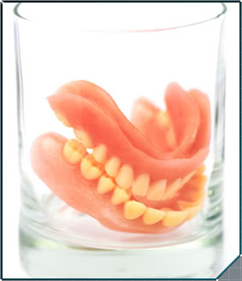
Denture base and underlying tissues
Denture base adaptation
  A properly formed denture base outline develops a seal that can be maintained during most of the normal oral functions
  Depends on impression procedures
    Extend all basal seat within limits of
    health and function….SNOW SHOE PRINCIPAL
    Selective pressure
    It should not damage tissues
    Dimensionally stable
    External form of impression….

Slide 12
Stability is compromised-
  Inflammed tissues
  Distorted or displaced tissues
  Hyperplastic tissues
Use of tissue liners, adhesives , fixatives

Slide 13
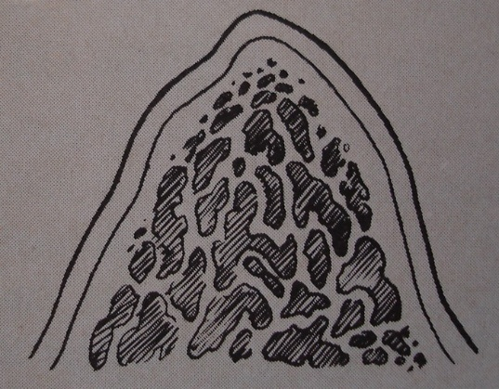
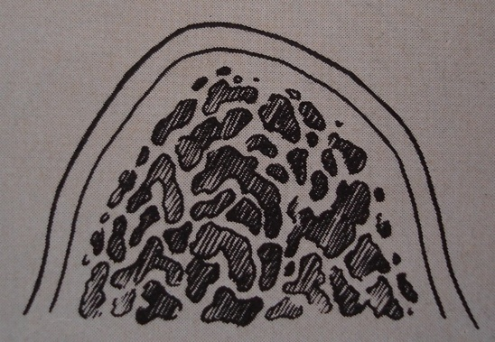
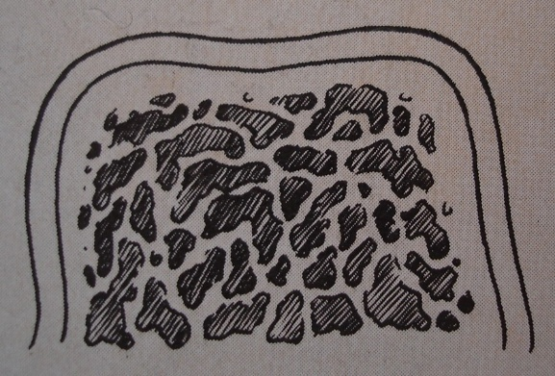
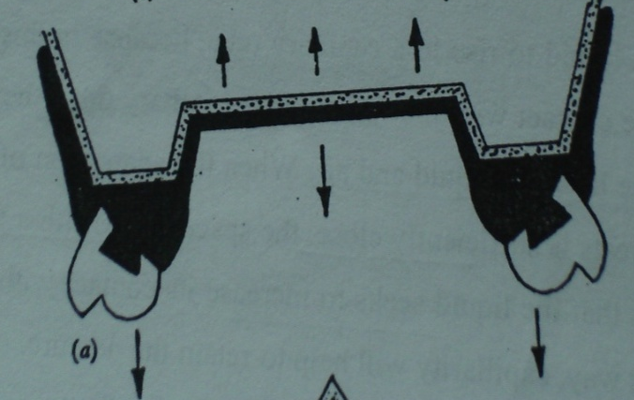
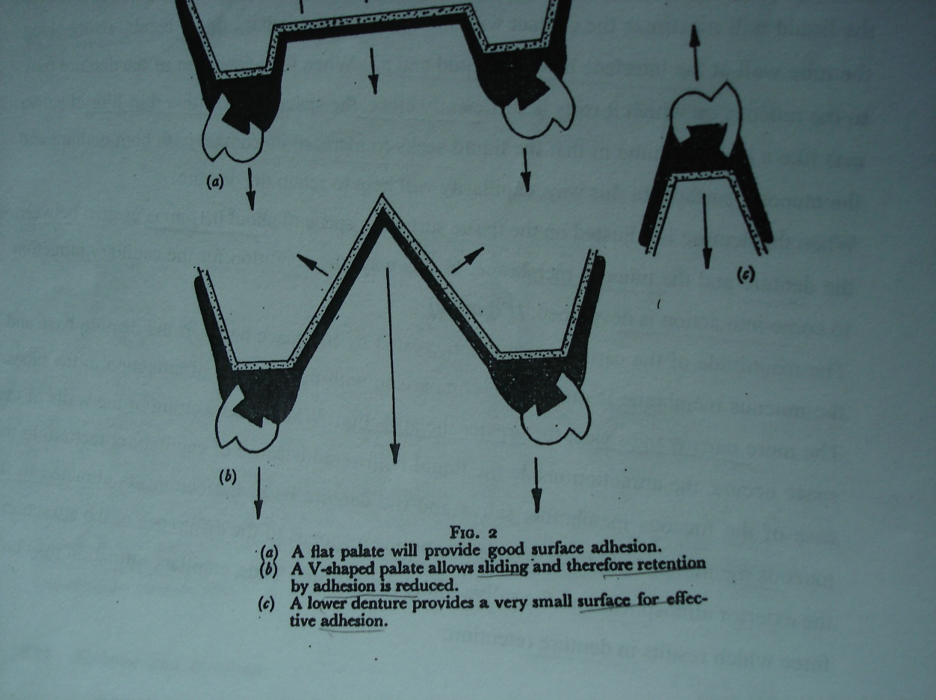
Residual ridge anatomy
Large, broad, square
Small, narrow, tapered
Arch form – square and taper arch tend to resist rotation than ovoid arch
Palatal vault

Slide 14
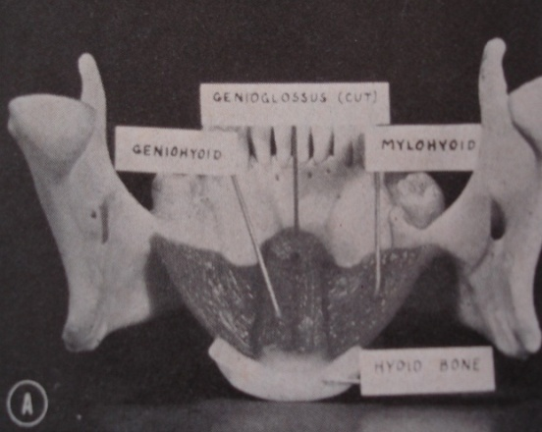
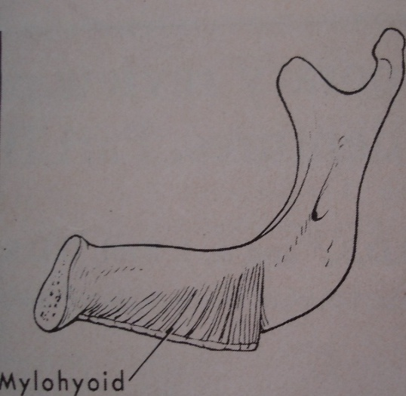
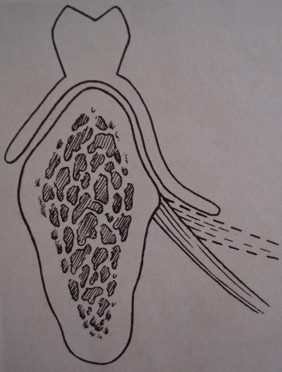
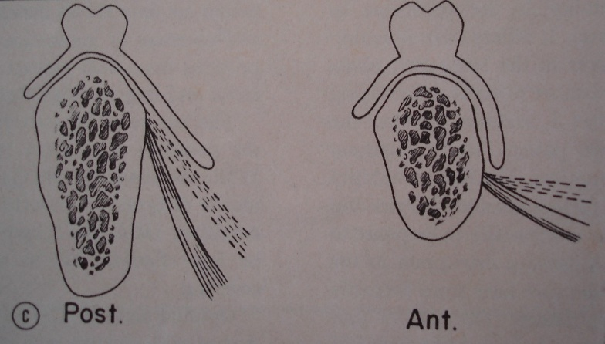
Mandibular lingual flange
Should be 90 degree to occlusal plane
Post flange can extend > anterior flange….
Sublingual crescent area…border seal and inc surface

Slide 15
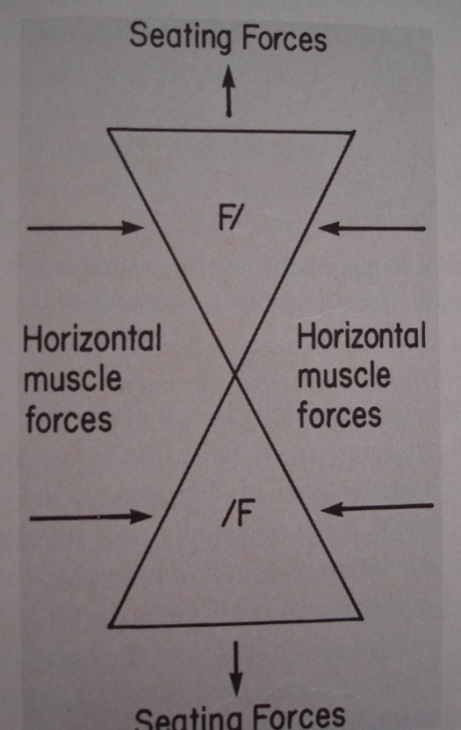
Surfaces of denture and surrounding orofacial musculature
Muscle action…. Vertical or lateral dislodging forces
Such as levator anguli oris, incisivus, depressor anguli oris, mentalis, mylohyoid, and genioglossus

Slide 16
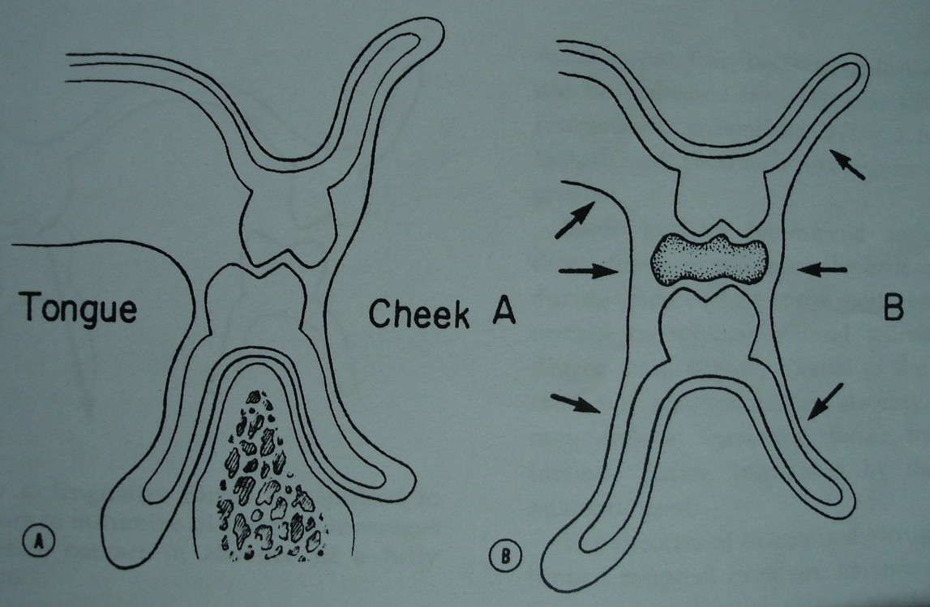
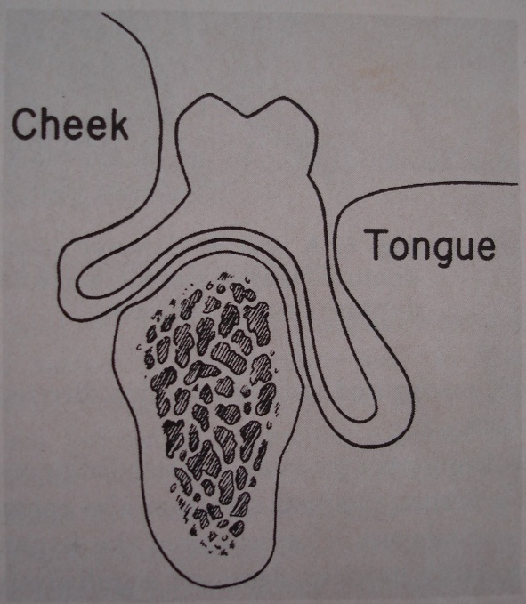
External surface of the denture
Fish… “the shape of buccal,labial and lingual surfaces can wreck stability as completely as a bad impression or a wrong bite”

Slide 17

Influence of orofacial musculature
The three structures …..tongue, the teeth and
the medial roll of the buccinator muscle
MEDIAL ROLL OF BUCCINATOR
Its main function is to form the buccal wall of the food trough and to retrieve food that is forced into the buccal pouch.
The buccal surface of the bicuspid forms a point of fixation for the medial roll of the buccinator and other muscles at the corner of the mouth that are commonly known as the purse-string muscles. ….. saliva and food inside the mouth during chewing and swallowing.

Slide 18
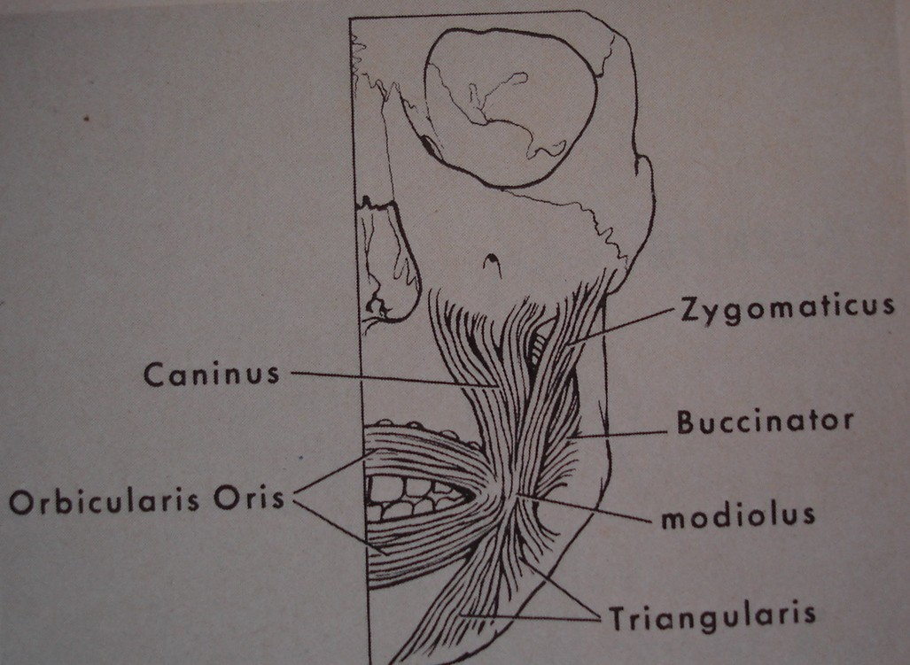
Modiolus and associated musculature
Tendinous node near corner of mouth formed by intersection of several muscles of cheeks and lips-

Slide 19
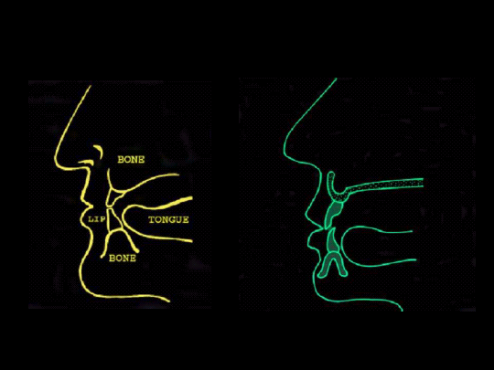
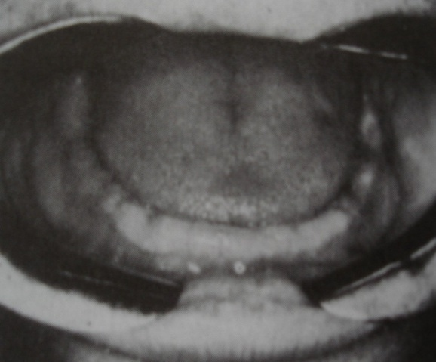
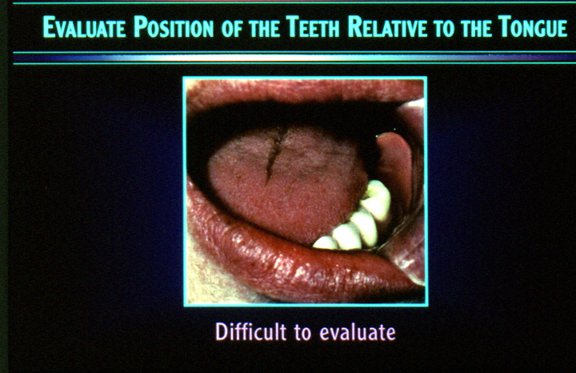
A normal tongue position has the
following characteristics
It completely fills the floor of the mouth.
The lateral borders rest over the ridge which would normally represent the occlusal surfaces of the teeth.
The tip or apex of the tongue rests on or is just to the lingual side of the lower anterior ridge

Slide 20
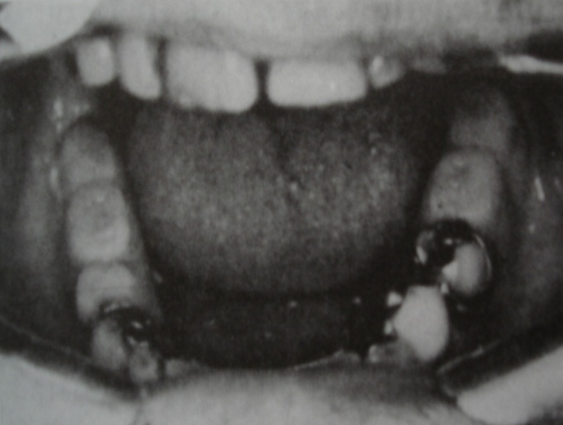
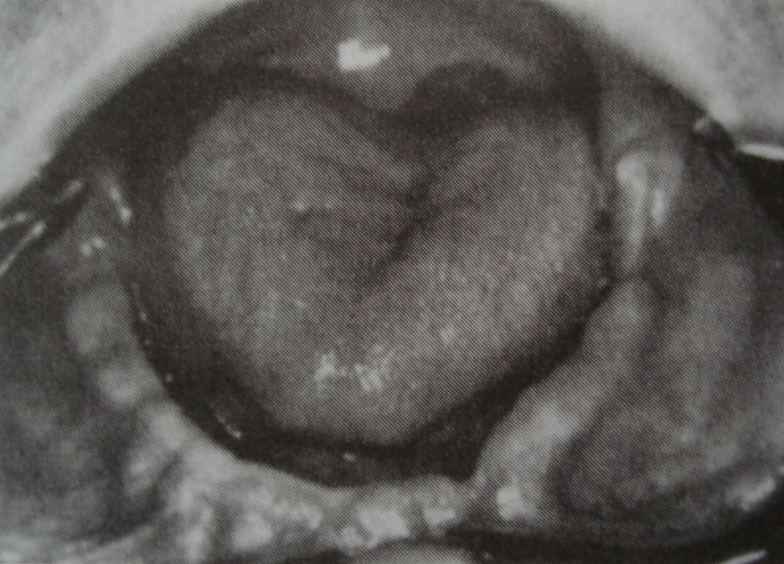
RETRACTED TONGUE POSITION
It is an awkward tongue position….
tongue is pulled back into mouth and the floor of the mouth is exposed.
lateral borders are either posterior to the ridge.
tip of the apex of the tongue sometimes lies in the posterior part of the floor of the mouth or be may be withdrawn into the body of the tongue.

Slide 21
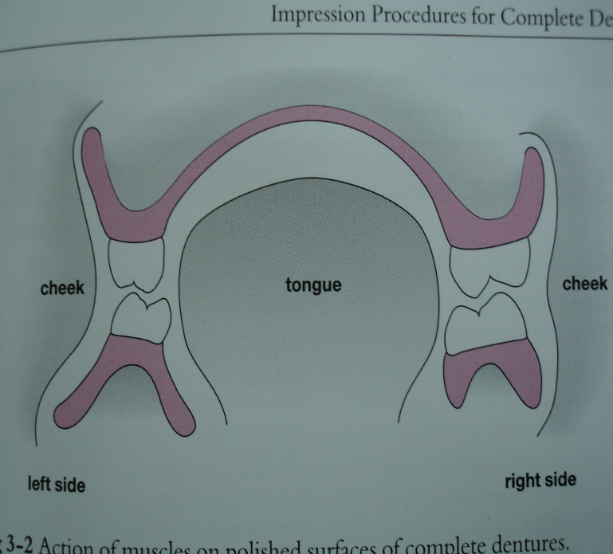
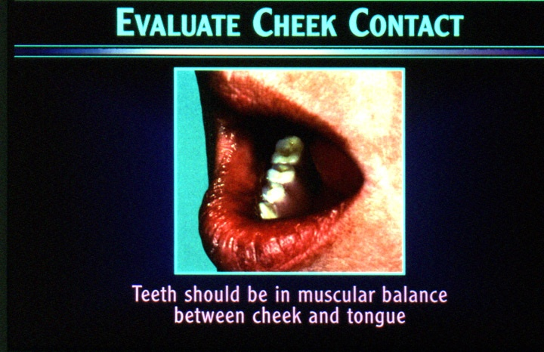
The neutral zone (NZ)
Area or position where the forces between tongue and cheeks or lips are neutralised
Fish… 1931
Tissues … functionally mold entire polished surface
Teeth should be placed within NZ

Slide 22
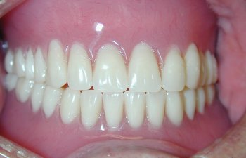
Relationship of opposing occlusal surfaces
Dentures should be free… interferences – within functional range
Premature contacts – uneven stresss
Bilateral balanced occlusion for lever balance….simultaneous and smooth glinding contacts

Slide 23
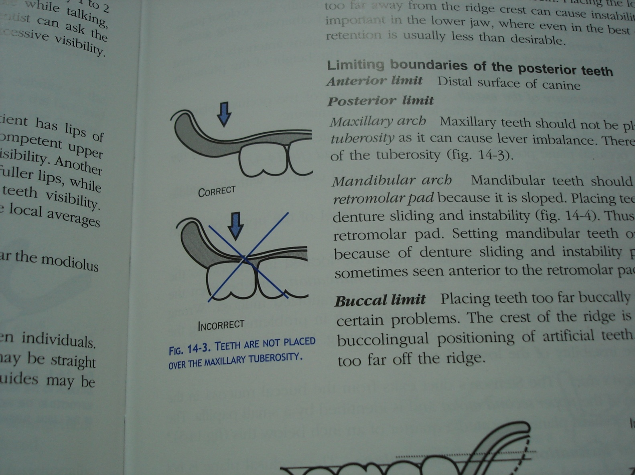
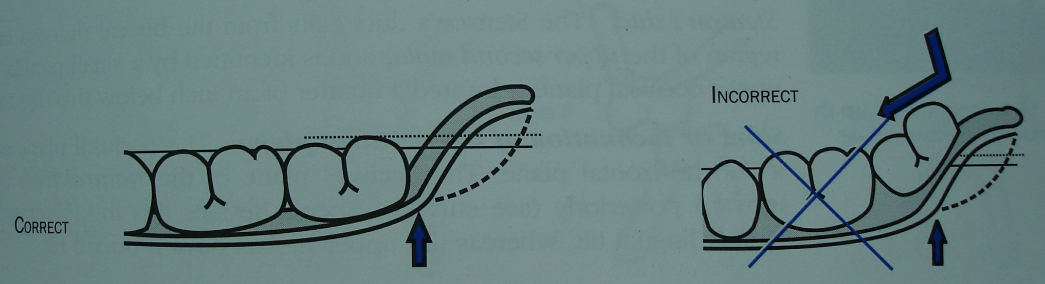
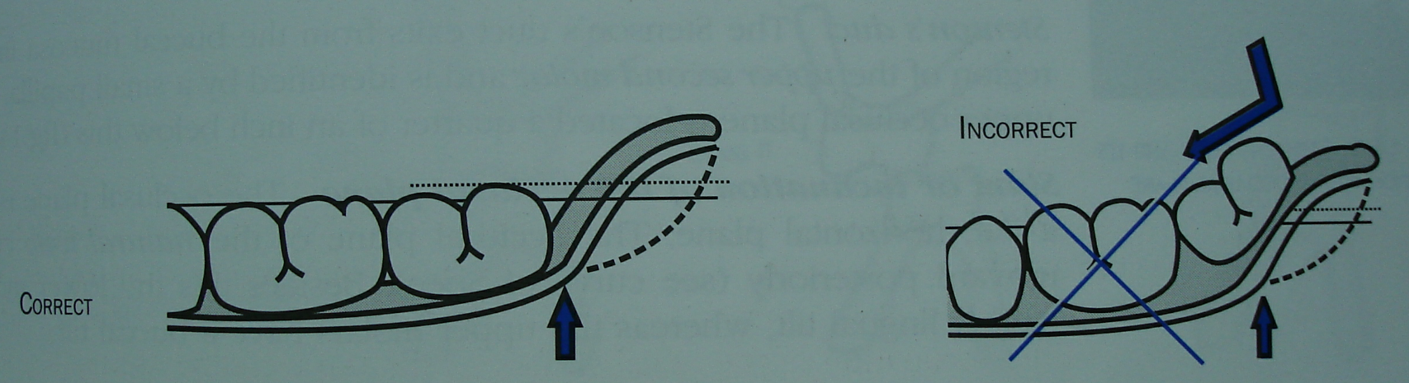
OCCLUSAL PLANE
Distance of occlusal plane from residual ridge
Anteriorly – interpupillary line/ corner of mouth
Posteriorly – camper’s plane / anterior 2/3rd of retromolar pad & lateral border of tongue

Slide 24
Ridge relationship
Offset ridge relations- creates problem in stability
Weinberg ….set teeth in cross bite when ridges are in severe cross bite
Class 2 ….
Class 3…criss cross arrangement given by- Goyal and Bhargava (1974)

Slide 25
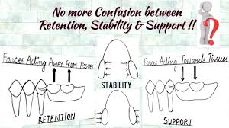
Conclusion

Slide 26
Take home message
The factor stability is very crucial in assisting the retention there by success of the dentures
Hence incorporation of all the factors carefully in the dentures is important . In spite having good retention if stability is compromised success of the denture too compromised.

Slide 27
List or references
Boucher’s prosthodontic treatment for edentulous patients - 11th edition
Complete denture prosthodontics, 2nd edition, john j. Sharry
Impressions for complete dentures, bernard levin
Problems and solutions in complete denture prosthodontics, david j. Lamb
Essentials in complete denture prosthodontics, 2nd edition, sheldon winkler.

Slide 28

Thank you

